Slide 1
Studio Web workshop Day 2 – UI Automation & Document Understanding
Speakers: Srini & Guna

Slide 2
About Me:
I have 6+ years of experience into RPA – UiPath.
Working as a Technical Architect in EY
UiPath MVP-2023

Slide 3
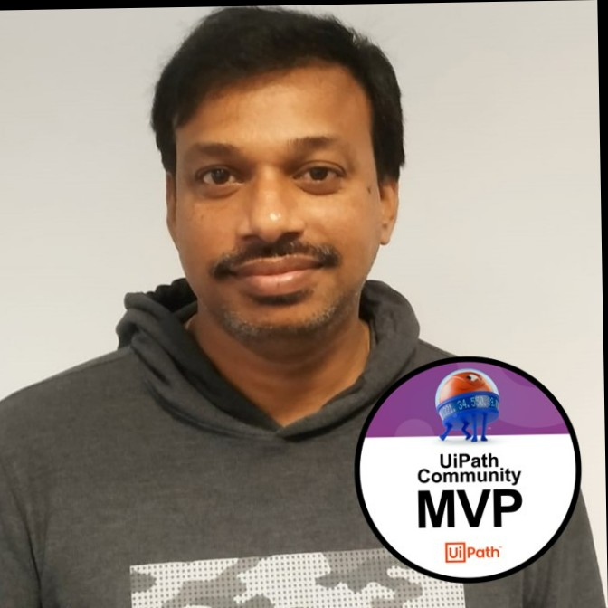
About Me:
I have 6+ Years of experience into RPA UiPath and around 11 Years of experience in IT Industry
Started My journey as a Java Developer and then moved into RPA
Now associated with Proservartner as an Sr. Technology Lead
I received UiPath MVP award for 2022 & 2023

Slide 4
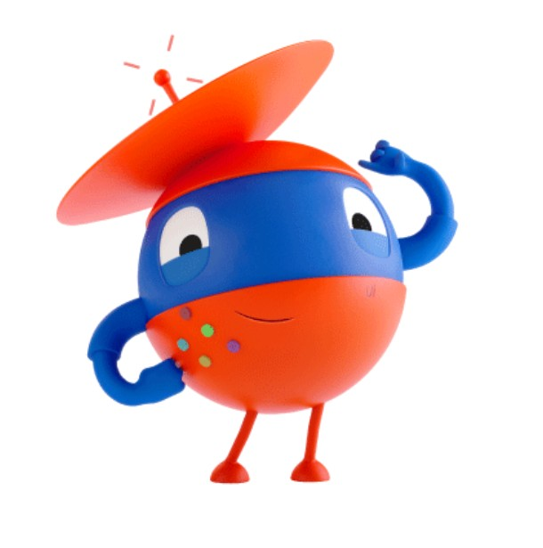
Key Take Aways…
1. Automate Web Apps in Studio Web
2. Ui Automation Activities in Studio Web
3. Cross Browser/Platform Compatibility
4. How to Install Chrome Extension
5. Demo’s
6. Q & A

Slide 5
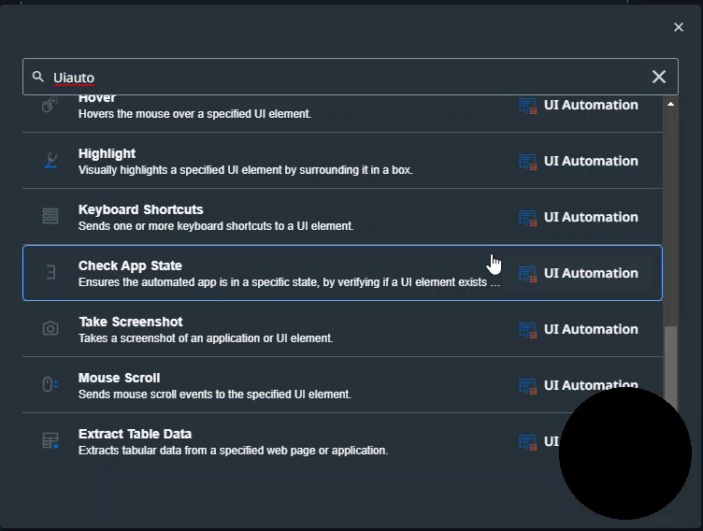
Ui Automation Activities in Studio Web

Slide 6
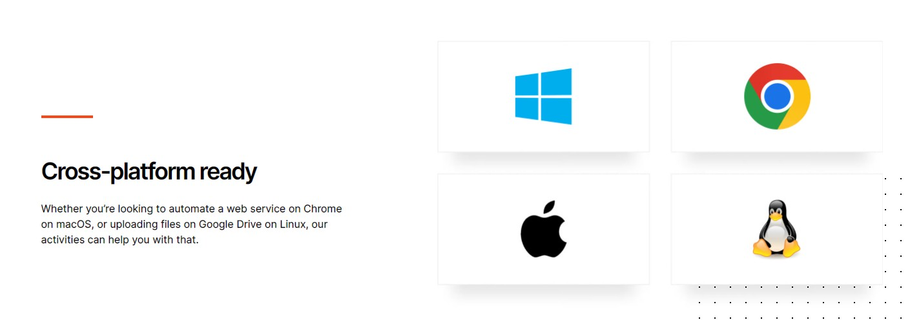
Cross Platform/Browser Compatibility

Slide 7
Studio Web Walk-through & Demo

Slide 8
Types of Documents in Real World
Structured
Repetitive forms and documents with a structured Template that can contain handwritten text, Signature, Checkboxes(forms, passports, licenses, timesheets)
Semi-Structured
Documents containing fixed and variable parts like tables (invoices, Receipts, purchase orders, medical bills, bank statements, utility bills)
UnStructured
Documents with no fixed format (various contracts, agreements, emails, disease description, drug prescriptions, news, voice scripts)

Slide 9
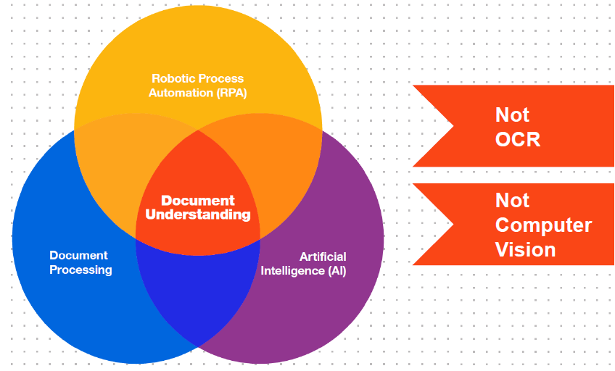
What is all about Document Understanding

Slide 10
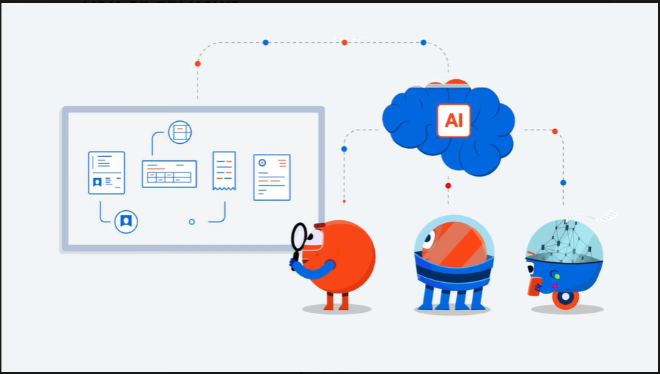
Document Understanding - Nutshell

Slide 11
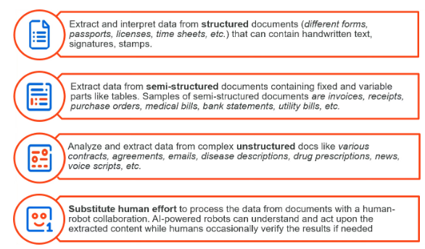
Let’s Robots handle your routine
Document Processing

Slide 12
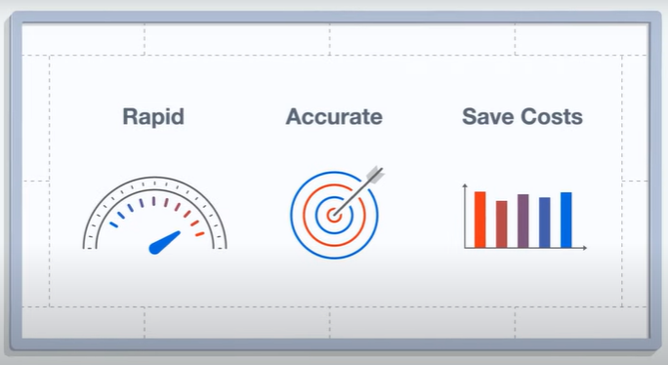
Why Document Understanding?

Slide 13
Studio Web Walk-through & Demo

Slide 14




Vibrant ecosystem of more than 2 million professionals and citizen developers learning,
getting support, and succeeding together in their automation careers.
Academy
Learn the skills of the future on UiPath Academy or through our Academic Alliance
Earn globally recognized credentials with UiPath Certifications
Forum
Get crowdsourced support and share product feedback on UiPath Forum
Check the product documentation
Community Events
Connect with like-minded people and share best practices with the UiPath Community
Solve challenges in engaging hackathon competitions
Join meetups and conferences
Join the UiPath Community

Slide 15
Challenge 1:
RPA Challenge

Slide 16





Thank You

